Slide 1

Eclipse Scout Creation Review, April 7th, 2010 Project Leads: Matthias Zimmermann, Andreas Hoegger

Slide 2
Eclipse Scout
Background
Business application developers face many recurring requirements. Implementing these should not require a significant amount of time. Instead, developers should be able to concentrate on understanding and implementing business cases.
Goals
Reducing development time for SOA and J2EE business applications based on the Eclipse platform
Providing a low entry barrier into building such applications.

Slide 3
Driving Values
Stability
Ensure that Eclipse Scout runs stable in every environment.
Flexibility
Allow for extension, enhancements, and adaptaion of Eclipse Scout and Scout SDK (Tooling for Scout) by providing Eclipse compliant extension points.
Simplicity
Evaluate every additional layer and abstraction carefully of its usefulness to keep the framework as light and simple as possible.

Slide 4
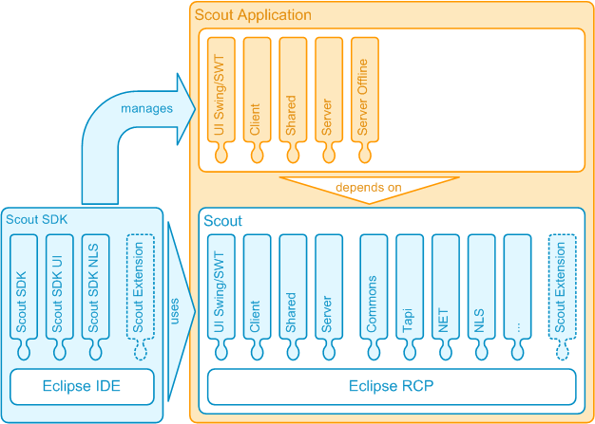
Project Scope
This proposal covers two main parts: Scout and Scout SDK, both are realized as fully compliant Eclipse plugin set.
Scout provides an application model, a reference implementations, and utilities proven to be useful for business application development.
The Scout SDK provides the tooling to build/ manage business applications based on Scout. This is achieved by generating pure Java code.

Slide 5
Main Features
Main Features of Scout
Scout application model for a clear and simple definition of business applications.
Abstract UI component model including Swing and SWT/JFace representations.
Exchangeable client server communication. A reference implementation using HTTP(S)
Remote service infrastructure.
Client notification for communication from the server to the clients
Support for integrating 3rd party libraries and applications
Main Features of Scout SDK
Wizard support for managing the Scout application model.
Real time synchronization of the application model and Java code.
Tooling for implementation of application services, and multi-language support.
Tooling for providing/consuming web services
Build and launch support for Scout applications.

Slide 6
Relations to Projects
PDE | Strong dependencies, including the plugin model
JDT | Strong dependencies, including type and compilation unit abstraction
Equinox | Equinox implementation is used on both the client and the server side
BIRT | Support for BIRT is scheduled
RAP | Support for RAP is scheduled
Riena | Friendly co-existence
ECF | Currently evaluating
Swordfish | Currently evaluating
EclipseLink | Currently evaluating
EMF | Scout application model will become an extension of the e4 workbench model

Slide 7
Initial Committers
Andreas Hoegger (BSI)
Andreas Hoegger is a senior IT architect for Eclipse based business solutions and a driving force behind the BSI‘s involvement with Eclipse. He is the main source code contributor for the Eclipse Scout SDK.
Ivan Motsch (BSI)
Ivan Motsch is a senior solution architect with comprehensive knowledge regarding Java/J2EE/Eclipse/Equinox, middle ware technologies, security, etc. He has been driving the Scout framework since 1998 and is the main source code contributor for the runtime part of Eclipse Scout.
Hannes Müller (BSI)
Hannes Müller is one of our most experiened software developers for products based on the Scout framework. He is responsible for the development of BSI CRM, also based on Eclipse Scout.
Stephan Leicht (BSI)
Stephan Leicht is a senior software developer with broad knowledge of Eclipse Scout. He has worked as technical lead on several projects based on the Scout Framework and takes responsibility in solving bugs on in the Scout Framework.

Slide 8
Mentors
Architecture Council Members
Jochen Krause (Innoopract)
Markus Knauer (Innoopract)
Thomas Schindl (BestSolution.at)

Slide 9
Interested Parties
Positive Feedback from Organisations
compeople
EclipseSource
Weigle Wilczek
schlag & rahm
Positive Feedback from Individuals
Gilles J. Iachelini
Aleksey V. Zapparov
Benjamin Muskalla (EclipseSource)
Frank Gerhardt (Gerhardt Informatics Kft.)
Michael Pucher (affinis)
Tonny Madsen (The RCP Company)
Ricco Deutscher (Sopera)

Slide 10
Code / Licencing
Initial Code Contribution
BSI AG holds all copyrights
Functionality described in this proposal will be provided by BSI AG.
All source code will be released under EPL licencing
Eclipse Scout is applying for the parallel IP process

Slide 11
Schedule
2010
Proposal presentation at EclipseCon
Project status, source code in Eclipse repository
BIRT / Jasper integration
2011
Web frontend integration
Participation in the annual Eclipse release train

Slide 12
Links
Proposal
http://www.eclipse.org/proposals/scout/
Forum
http://www.eclipse.org/forums/index.php?t=thread&frm_id=174
Wiki
http://wiki.eclipse.org/scout
Blog
http://www.bsiag.com/scout/

